Slide 1
MVC Architecture
Model View Controller

Slide 2
What is MVC?
MVC is a widely used software architectural pattern in GUI-based applications.
It has three components, namely
a model that deals with the business logic,
a view for the user interface, and
a controller to handle the user input, manipulate data, and update the view.

Slide 3
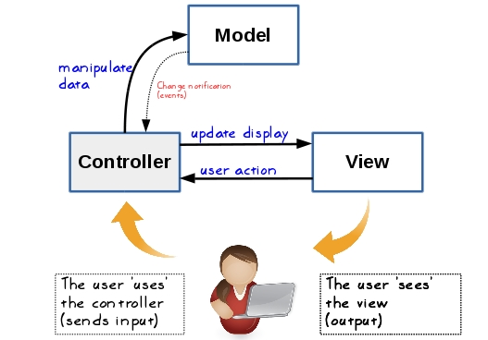
MVC

Slide 4
MVC
MVC is a widely used software architectural pattern in GUI-based applications.
Model View Controller or MVC as it is popularly called, is a software design pattern for developing web applications.
Model–View–Controller (usually known as MVC) is a software design pattern commonly used for developing user interfaces which divides the related program logic into three interconnected elements. This is done to separate internal representations of information from the ways information is presented to and accepted from the user. Following the MVC design pattern decouples these major components allowing for code reuse and parallel development.

Slide 5
Model
Model represents shape of the data and business logic. It maintains the data of the application. Model objects retrieve and store model state in a database.
The model is responsible for managing the data of the application. It responds to the request from the view and it also responds to instructions from the controller to update itself.
The central component of the pattern. It is the application's dynamic data structure, independent of the user interface. It directly manages the data, logic and rules of the application.
Most Common – Java, Python, Ruby

Slide 6
View
View is a user interface. View display data using model to the user and also enables them to modify the data.
It means presentation of data in a particular format, triggered by a controller's decision to present the data. They are script-based templating systems like JSP, ASP, PHP and very easy to integrate with AJAX technology.
Any representation of information such as a chart, diagram or table. Multiple views of the same information are possible, such as a bar chart for management and a tabular view for accountants.
Most Common – JavaScript, HTML, PHP

Slide 7
Controller
Controller handles the user request. Typically, user interact with View, which in-turn raises appropriate URL request, this request will be handled by a controller. The controller renders the appropriate view with the model data as a response.
The controller is responsible for responding to the user input and perform interactions on the data model objects. The controller receives the input, it validates the input and then performs the business operation that modifies the state of the data model.
Accepts input and converts it to commands for the model or view.
E.g. : Java, Python, Ruby

Slide 8
Goals of MVC
1. Simultaneous development
Because MVC decouples the various components of an application, developers are able to work in parallel on different components without affecting or blocking one another.
For example, a team might divide their developers between the front-end and the back-end. The back-end developers can design the structure of the data and how the user interacts with it without requiring the user interface to be completed. Conversely, the front-end developers are able to design and test the layout of the application prior to the data structure being available.
2. Code reuse
The same (or similar) view for one application can be refactored for another application with different data because the view is simply handling how the data is being displayed to the user.

Slide 9
Advantages
Simultaneous development – Multiple developers can work simultaneously on the model, controller and views.
High cohesion – MVC enables logical grouping of related actions on a controller together. The views for a specific model are also grouped together.
Loose coupling – The very nature of the MVC framework is such that there is low coupling among models, views or controllers.
Ease of modification – Because of the separation of responsibilities, future development or modification is easier
Multiple views for a model – Models can have multiple views

Slide 10
Disadvantages
Code navigability – The framework navigation can be complex because it introduces new layers of abstraction and requires users to adapt to the decomposition criteria of MVC.
Multi-artifact consistency – Decomposing a feature into three artifacts causes scattering. Thus, requiring developers to maintain the consistency of multiple representations at once.
Pronounced learning curve – Knowledge on multiple technologies becomes the norm. Developers using MVC need to be skilled in multiple technologies.

Slide 11
Links:
https://developer.mozilla.org/en-US/docs/Glossary/MVC
https://medium.com/clarityhub/low-coupling-high-cohesion-3610e35ac4a6
https://en.wikipedia.org/wiki/Model%E2%80%93view%E2%80%93controller

